Slide 1






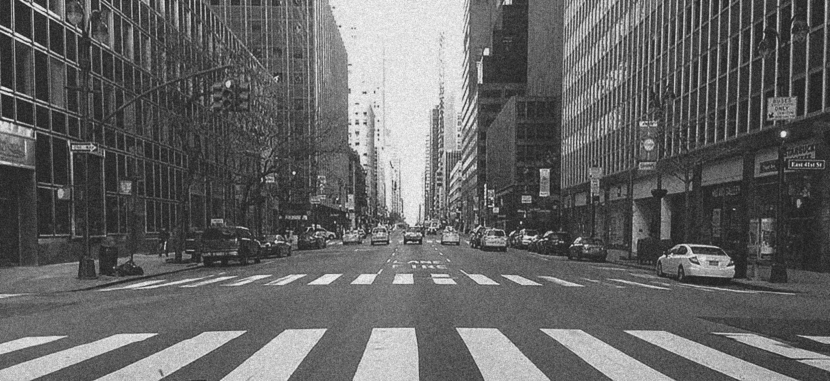

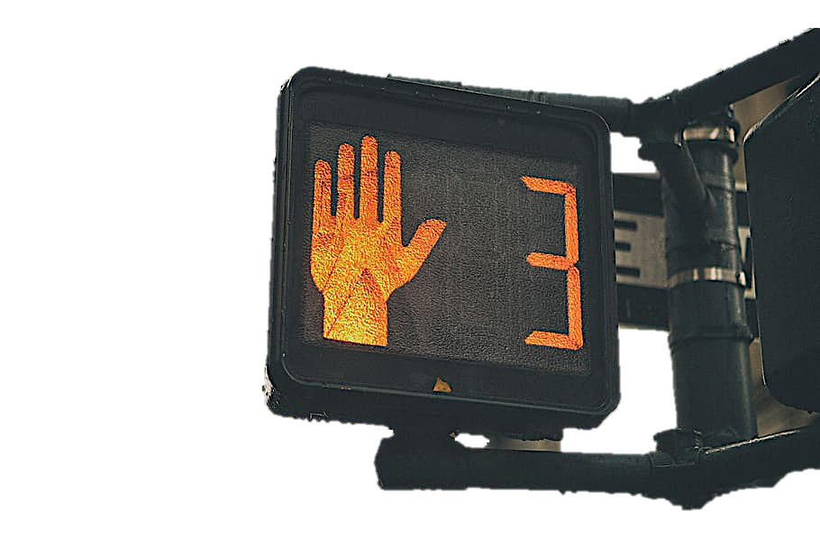
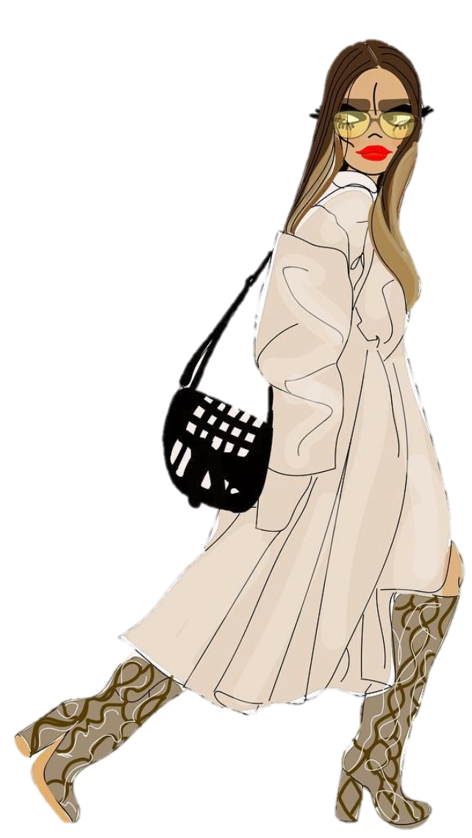
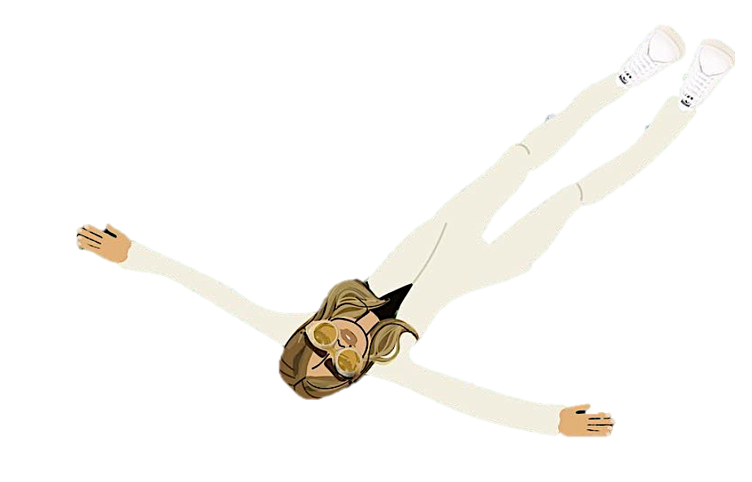




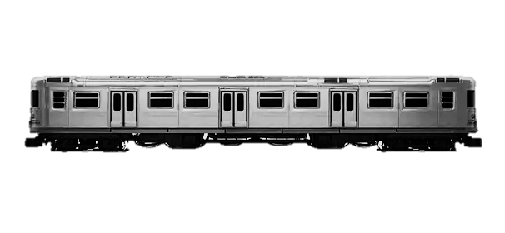


ugh I missed my ride
finallyyy here.
break’s over. class time.
ok, now I got to find the subway station.
oh, there it is. thank god
Siri, play RITMO
dead.

Slide 2




let the nightmare begin.

